Slide 1
Continual Learning using Synaptic Intelligence
Aparna Bhutani (ab8473@nyu.edu)
Twishikana Bhattacharjee (tb2517@nyu.edu)
Advanced Machine Learning Project - Spring 2020

Slide 2
Learning in Machines
 | Supervised | Reinforcement | Continual
Type of learning | Learns from a teacher generate data | Learns from a self-generated data but is teacher-motivated in nature | Learning is self-motivated and autonomous in nature
Main Issue | Generalization | Generalization Exploration-Exploitation Delayed Reward | Generalization Exploration-Exploitation Delayed Reward What to learn?
*Information from Lecture on Intrinsic Rewards and Continual Learning by Satinder Singh at Microsoft Research Published on 12-Jun-2018 (Youtube)

Slide 3
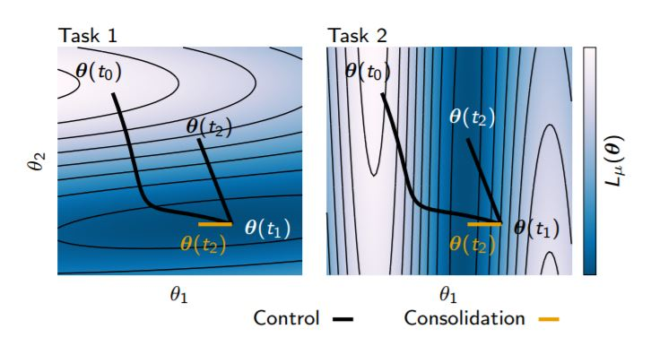

Synaptic Framework
Inspired from the concept of synapses in human brain.
Attempts at bringing some of the human brain complexity in the ANNs
Figure taken from Continual Learning Through Synaptic Intelligence by Zenke, Poole and Ganguli (2017)
We consider the change in loss for an infinitesimal parameter update δ(t) at time t. The change in loss is well approximated by the gradient g=δL/δθ and we can write :

Slide 4



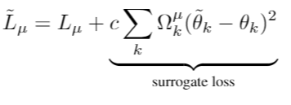


Synaptic Framework
I is the parameter specific contribution to changes in the total loss. The minus sign has been introduced in the second line because typically the interest is in
decreasing the loss
A surrogate loss is introduced to avoid large changes in important parameters
is the per-parameter regularization strength that is represented as follows:

Slide 5
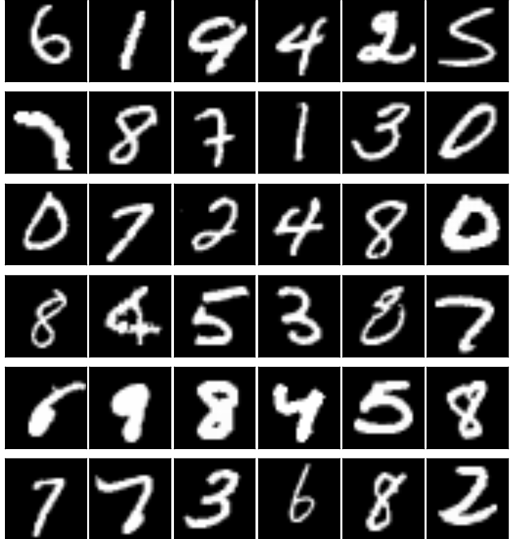
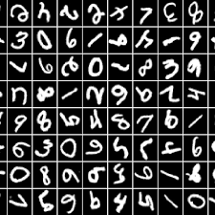
Dataset used for the implementation
Original MNIST dataset (Task 1)
Rotated MNIST dataset (Task 2)
We have used the MNIST and Rotated MNIST dataset for our implementation of the Synaptic Framework.
We have done the comparative analysis using these dataset as well

Slide 6
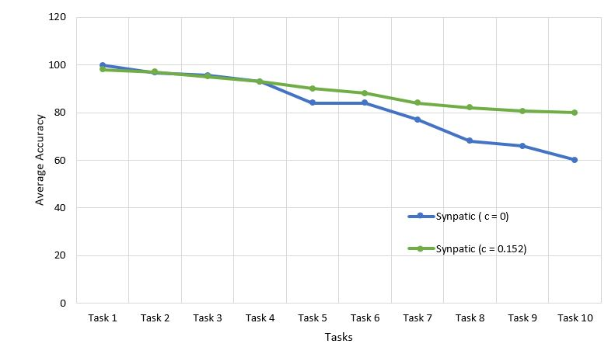
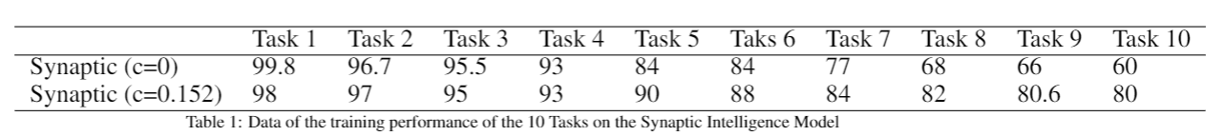
Performance Analysis
Control vs Experiment
We can clearly see that for the first task, the performance of the control setting, c=0 is almost 100% accurate.
For control (blue), Task 1 to Task 10 performance goes from a 99.8% accuracy to a mere 60% accuracy, dropping by almost 40%.
For the experiment setting (green), c = 0.152, we do not see a 100% accuracy with task 1.
But for the experiment accuracy goes from a 98% to 80% dropping by 18% only which is half of what the control setting

Slide 7
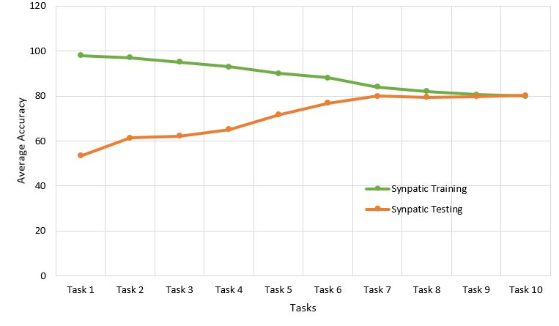
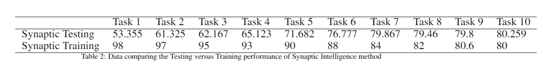
Performance Analysis
Training vs Testing
The Testing (orange) Vs Training (green) plot emulates the expected behaviour.
We observe a certain level of forgetting as we train the model with newer tasks.
With the test dataset, the model performs worst on the task that it had learnt in the very beginning and exhibits best performance in the task that it has learnt most recently.
We observe the same accuracy on both testing and training data for Task 10.

Slide 8

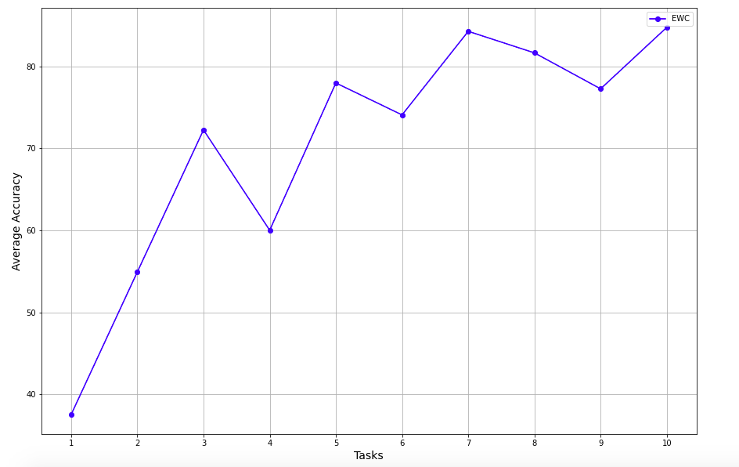
Elastic Weight Consolidation
Loss Function :
Performance of EWC on our dataset:
EWC prevents catastrophic forgetting by constraining important parameters to stay close to their old values when performing new tasks
Calculates update depending on Fisher information metric is a separate phase at the end of each task

Slide 9

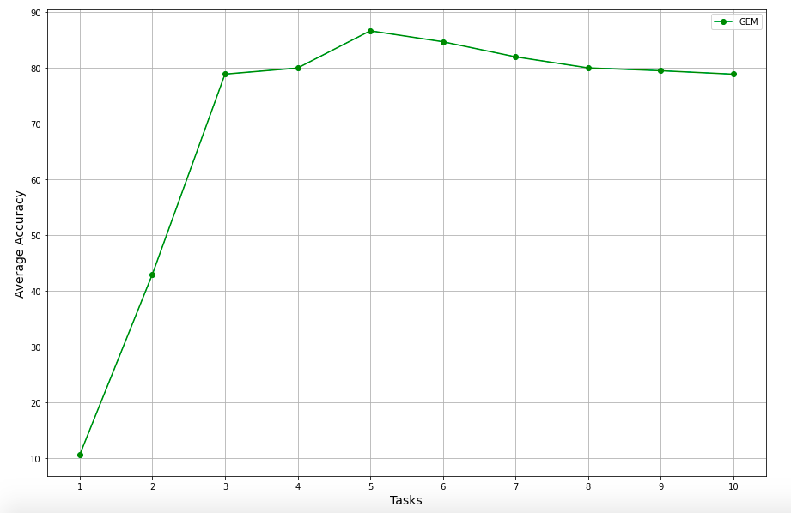
Gradient Episodic Memory
The GEM theory starts at the following equation :
On readjusting the above equation, we end up with the following:
On solving the primal and dual, we get the equation for projected gradient:
The GEM method focuses on a feature called the episodic memory which is used to store a subset of observed examples from the task
Performance of GEM on our dataset:

Slide 10
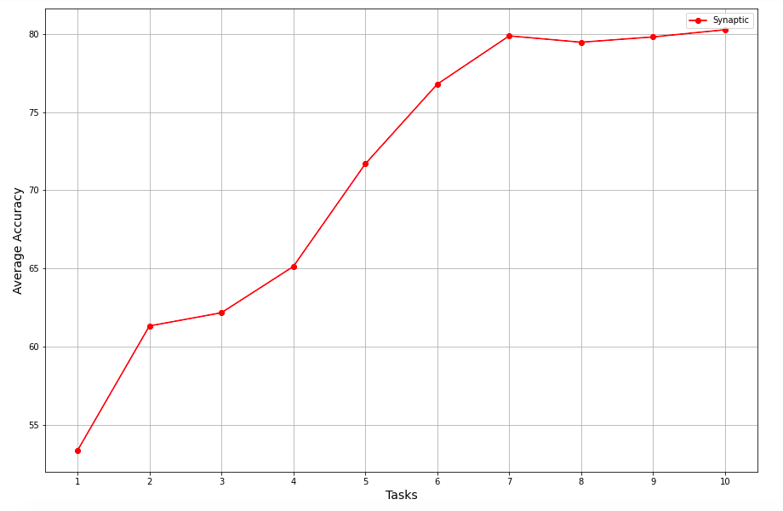
Performance Comparison Table
Synaptic
Intelligence
EWC
GEM
 | Task 1 | Task 2 | Task 3 | Task 4 | Task 5 | Task 6 | Task 7 | Task 8 | Task 9 | Task 10
EWC | 37.55 | 53.942 | 72.26 | 60.028 | 77.984 | 74.09 | 84.28 | 81.65 | 77.26 | 84.764
Synaptic Intelligence | 53.35 | 61.325 | 62.16 | 65.123 | 71.682 | 76.77 | 79.86 | 79.46 | 79.8 | 80.259
GEM | 10.6 | 42.98 | 78.89 | 79.98 | 86.66 | 84.7 | 81.99 | 79.5 | 78.88 | 80.01

Slide 11
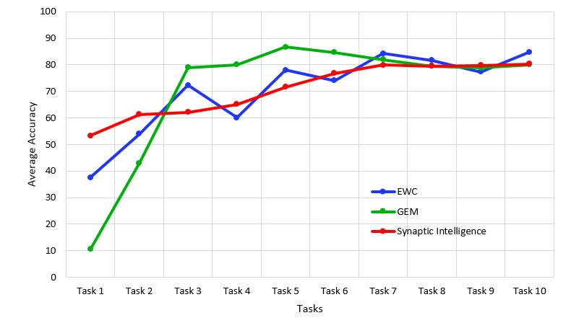
Comparative
Analysis
To make a comparative analysis of the data, we plotted the 3 performances on the same graph and also averaged the accuracy over the 10 tasks.
We used the average and the range between worst and best accuracy as a metrics to compare the performances
 | Average over Tasks | Range
EWC | 70.38 | 47%
GEM | 70.4 | 76%
Synaptic | 70.97 | 26.9%

Slide 12
Thank You

